Slide 1
BGP Route Policies
BGP route policies let you set rules to filter BGP routes or modify BGP route attributes.
You can apply BGP route policies to both inbound and outbound BGP routes. You use the Common Expression Language (CEL) to define the BGP route policies to apply to your BGP routes.
Note: BGP route policies are not supported for custom learned routes. BGP route policies are only supported for routes learned directly from the BGP peer.
BGP route policies are defined as an ordered list of terms. Each term is evaluated in the order that you specify, and include both a condition and a corresponding action for when a route matches that term.
A particular BGP route policy can be applied only in one direction, either inbound for learned routes, or outbound for advertised routes, but not both simultaneously. However, BGP route policies can be applied to multiple BGP peers on Cloud Router.

Slide 2
BGP Route Policies Use Cases
You can use BGP route policies to control which BGP routes are accepted, rejected, or modified before the BGP routes are advertised to other BGP peers or imported to the VPC routing table.
Modifying the best-preferred BGP route: You can use BGP route policies to modify the best-preferred BGP route, which is helpful for influencing the path that traffic takes through a network. For example, you can use BGP route policies to help ensure that BGP routes from a particular peer are preferred over other BGP routes by changing the value of the BGP MED attribute.
Filtering unwanted BGP routes: You can use BGP route policies to filter unwanted learned routes, or to avoid advertising particular routes to BGP peers. This is useful to prevent routing loops or routes that send traffic through undesirable paths. For example, you can use BGP route policies to filter prefixes within a subnet.
Meeting traffic engineering goals: You can use BGP route policies to meet specific traffic engineering goals. To influence traffic distribution, prepend one or more values to a route's AS-PATH.

Slide 3
How BGP route policies are applied
You apply BGP route policies to BGP configurations on a Cloud Router. Each BGP peer has zero or more route import and export policies applied to it. Import route policies apply to inbound routes, and export route policies apply to outbound routes.
The following describes the general rules that Cloud Router follows when applying BGP route policies:
BGP route policies are evaluated in the order that you list.
Terms in each BGP route policy are evaluated in the order of specified priority.
Terms can modify BGP routes. A subsequent term can modify a BGP route made by a previous term.
Evaluation ends when a BGP route is accepted or dropped. BGP routes are accepted if all policies and terms are evaluated and the route isn't dropped.
Terms aren't evaluated twice for a route in a single exercise of a BGP route policy.
BGP route policy evaluation defaults to fail open. In other words, routes that aren't explicitly dropped are accepted during BGP route policy evaluation. You can't change this behavior directly, but you can create a "drop all" policy that you apply to your last peering, in effect creating a fail closed BGP route policy.

Slide 4
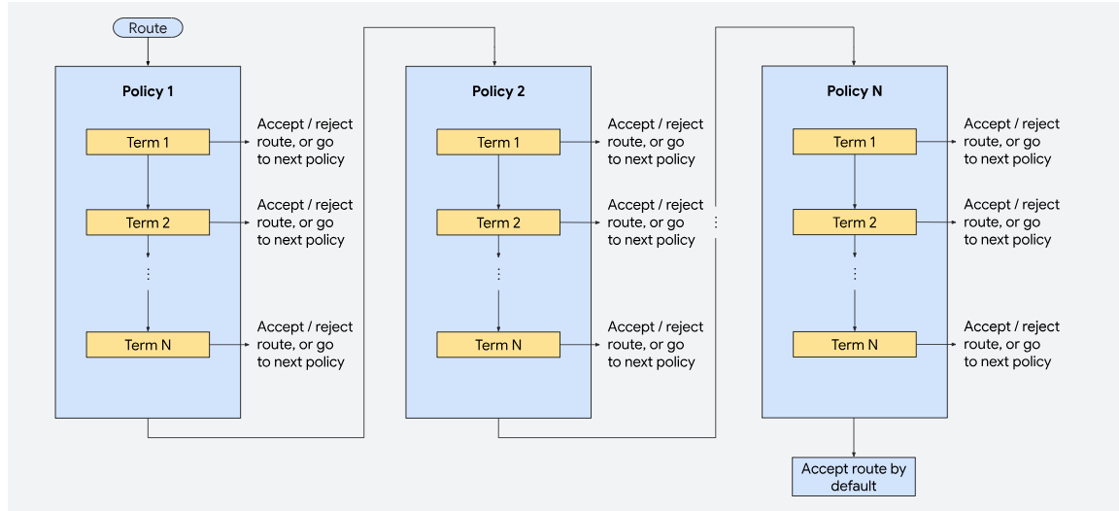
How BGP route policies are applied

